Slide 2
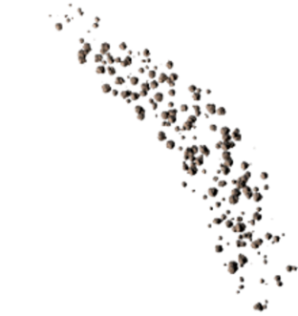

The Shattered Plains System
Freeport 3
Freeport 2
Mars
Asteroid Field
Freeport 1
Freeport 4
Earth
Dense Asteroid Field
Iridus
Ravcor

Slide 3
Spheres of Influence
SOI 2
SOI 3
Freeport 2
Freeport 3
SOI 1
Mars
Asteroid Field
Freeport 1
Freeport 4
SOI 4
Earth
Neutral Zone
Dense Asteroid Field
Iridus
Ravcor

Slide 4
Rare Resource Distribution
Gold Silver
Freeport 3
Freeport 2
Iron, Cobalt, Nickel
Mars
Asteroid Field
Platinum
Freeport 1
Freeport 4
Earth
Magnesium
Dense Asteroid Field
Iridus
Ravcor

Slide 5
Freeport Trades
Freeport 1 – Earth
The Earth Freeport is at the center of high tech advancements for the system.
Trade Routes
Buy adv. components
Sell basic components
Sell rare ingots
Buy Ice
Sell Munitions
Freeport 2 – Mars
The Mars Freeport is the blue color industrial juggernaut of the System and also highly militaristic.
Trade Routes
Buy ingots
Buy basic components
Buy basic ore
Sell precious ore
Sell adv. Components
Buy Ice
Buy Munitions
Freeport 3 - Deep Space
Freeport 3 is a major trade hub for rare and valuable materials
Trade Routes
Buy precious ore
Sell basic components
Sell Ice
Freeport 4 – Neutral Space
Buys/Sells All Goods
Default System Prices
Trade Routes
Sell basic ore
Sell Ice

Slide 6
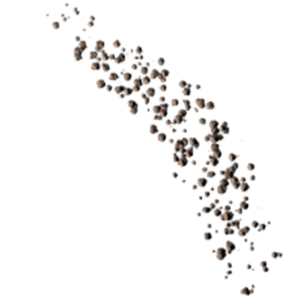

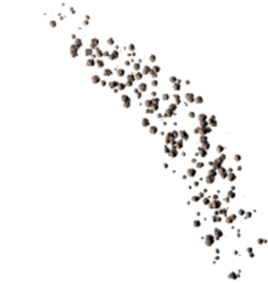
Shattered Plains: Omicron System
Colony Ship 2
(Crashed)
Colony Ship 1
0,1000
Class K
Asteroid Field A
Class M
0,0
Freeport
Asteroid Field C
Colony Ship 3
Class Y
Colony Ship (Lost)
Class D
Asteroid Field B
Notes:
Class D (planetoid or moon with little to no atmosphere)
Class H (generally uninhabitable)
Class J (gas giant)
Class K (habitable, as long as pressure domes are used)
Class L (marginally habitable, with vegetation but no animal life)
Class M (terrestrial)
Class N (sulfuric)
Class R (a rogue planet, not as habitable as a terrestrial planet)
Class T (gas giant)
Class Y (toxic atmosphere, high temperatures)

Slide 7
Spheres of Influence
SOI 2
SOI 1
Class K
Class M
SOI 4
Freeport
Neutral Zone
SOI 3
Class D
Class Y

Slide 8
High Yield Resource Highlights
Common Ores
Colony Ship 2 (Crashed)
Iron, Nickel, Silicon, Ice
Class K
Iron, Nickel, Cobalt, Magnesium
Colony Ship 1
Asteroid Field A
Class M
Freeport
Asteroid Field C
Colony Ship 3
Uranium
Platinum, Silver, Gold
Colony Ship (Lost)
Class D
Class Y
Asteroid Field B

Slide 9
Resource Distribution
Exclusive High Yield Unavailable
Fe, Ni, Co, Mg, Si, Ag, Au, Pt, U, Ice
Colony Ship 2 (Crashed)
Fe, Ni, Co, Mg, Si, Ag, Au, Pt, U, Ice
Fe, Ni, Co, Mg, Si, Ag, Au, Pt, U, Ice
Colony Ship 1
Class K
Asteroid Field A
Class M
Freeport
Asteroid Field C
Fe, Ni, Co, Mg, Si, Ag, Au, Pt, U, Ice
Colony Ship 3
Fe, Ni, Co, Mg, Si, Ag, Au, Pt, U, Ice
Colony Ship (Lost)
Class D
Class Y
Asteroid Field B
Notes:
Fe, Ni, Co, Mg, Si, Ag, Au, Pt, U, Ice

Slide 10
